Slide 1
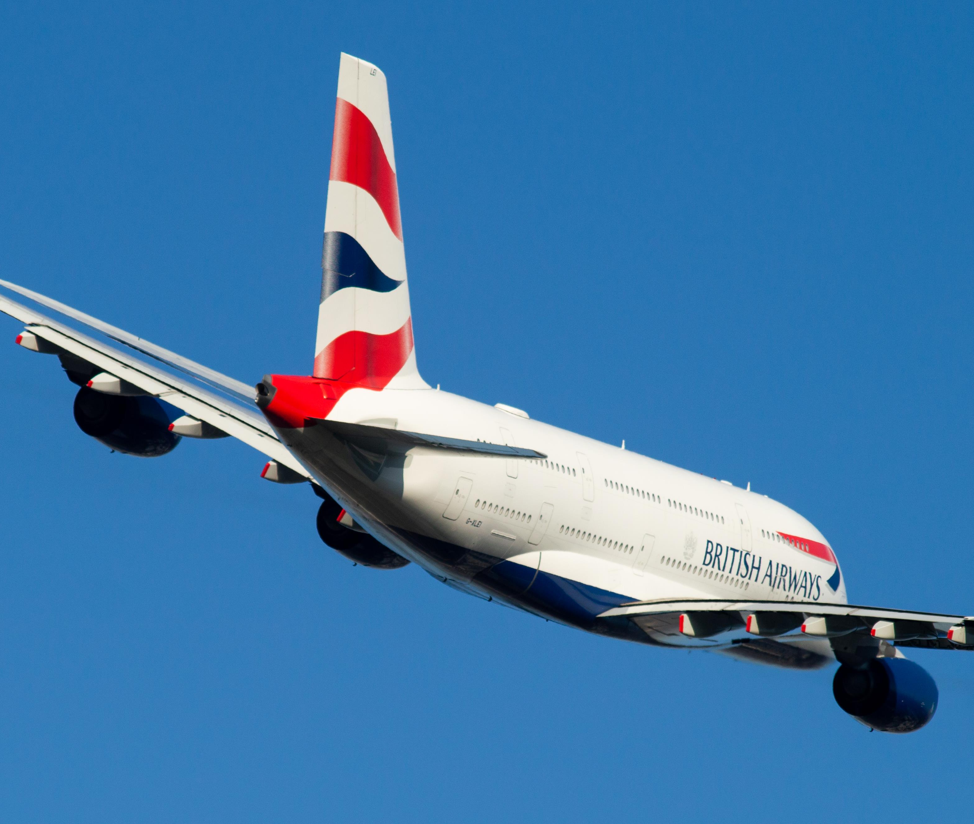
UK Flight Punctuality Statistics 2022
A Presentation by Team Aden

Slide 2
Agenda
1. Data Pre-Processing and EDA
2. Key Insights
3. Trend Analysis

Slide 3
Problem Statements
We must clean the data and make it ready for analysis.
We will observe the distribution of the data.
We will discuss the Average Delay by Minutes for each Month.
We must find the Number of Flights Delayed and Cancelled of each airline.
We must find the Percentage of Flights Delayed and Cancelled group by Airlines.
We must find the Percentage of Flight Share among Airports in the UK.
We must find the Average Delay in Minutes by Month at an Airport in the UK .
We must find the Percentage of Number of Flights Delayed at an Airport in the UK

Slide 4

Data Introduction
The data we are going to work on today is retrieved from UK CAA Flight Punctuality Statistics.
The selected data is for Reporting Month 04 and 05. Report 04 is for June and 05 is for July.
It holds all the records which can be used to derive punctuality statistics for the flights and airport.
Notes:
It involves data of British and Non-British, Airports and Airlines. The data has flights departed from the UK and arrived in the UK.
It also tells if a flight is Chartered or Scheduled.
It contains data about number of flight on a specific route and the percentage of flights delayed on that route with Average Delay and Cancelled.

Slide 5
Statistical Data Description
The data is in csv format. We have two separate files for data. One contains data of June and the other contains the data of July. It is pre-separated. It consists of 26 Features and 11,466 Instances in total. It has 7 Categorical and 19 Numerical Columns

Slide 6
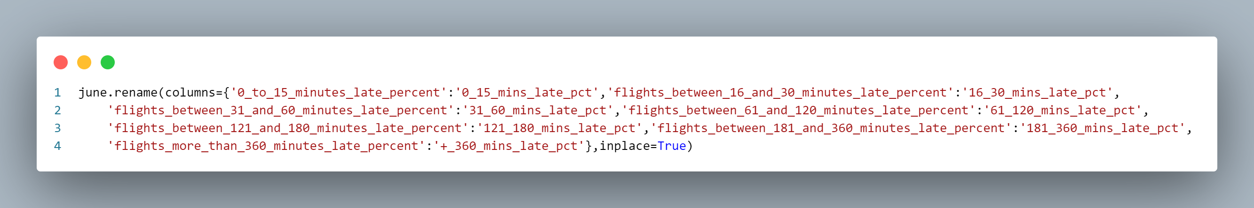
Data Pre-Processing
We removed the unnecessary columns.
We rename the columns to access them easily.
We handled null values by dropping them.
We added new columns e.g Delay_Pct to sum up all the percentage columns into one.
We added another column, number of flights cancelled.

Slide 7
Key Insights and Trend Analysis

Slide 8
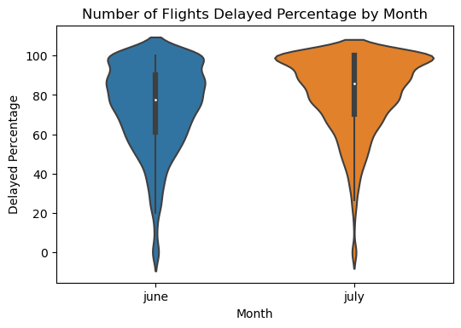
Violin Plot
This graph shows the Number of Flights Delayed Percentage by Month
Notes:
A violin plot, which depicts data peaks, is a cross between a box plot and a kernel density plot.
The Median of July is higher than June which tells us that there is more number of observaations in july.
For July there are more chances for a flight to get delayed because the Quantiles are greater than June's Quantiles.

Slide 9
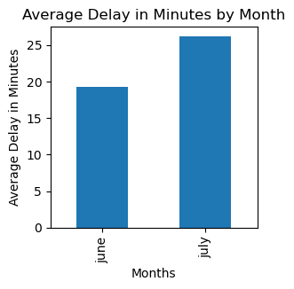
Average Delay in Minutes by Month

Slide 10
Percentage of Flights Cancelled and Delayed By Airline
This graph shows us the delay and cancellation percentage of each airlines .
Notes:
This graph shows us the delay and cancellation percentage of each airlines Wizz air had the highest percentage of flights delayed in June.
Wizz Air had highest percentage of delays at 90% followed by Lufthansa at 88% and KLM 85% in June.
Easy Jet had 68% whereas Ryan Air had 69% of flights delayed in June which are the two most popular airline in the Uk
Logan Air had the highest number of cancellations in June about 3% followed by BA and KLM
In July Wizz Air was replaced by TUI with 91% of it’s flight delayed with Wizz Air coming 2nd , 89% of flights delayed.
The order remained the same for next as well. Wizz Air was followed by Lufthansa and KLM. Which almost had the same percentage as before.
KLM had the highest number of cancellations at 3.3%

Slide 11
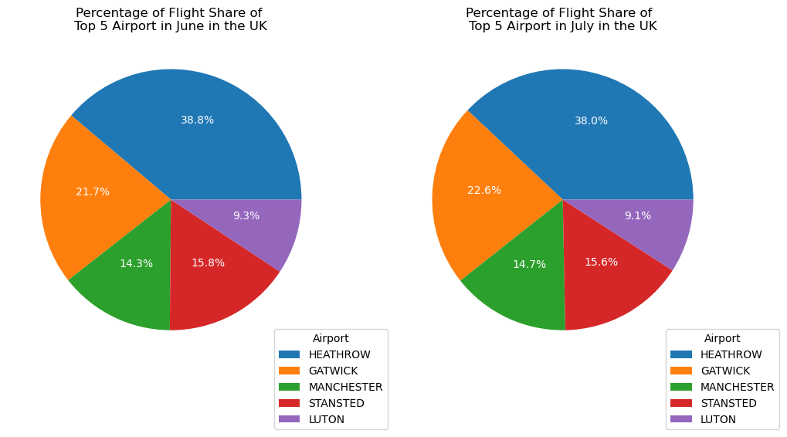
Airport Share in the UK Aviation Market

Slide 12
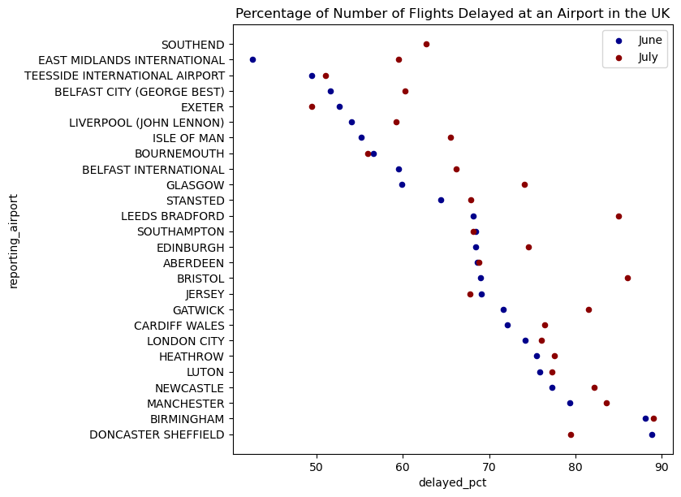
Percentage of Flights Delayed at an Airport
This graph shows us the average delay in percentage of each airport.
Notes:
This graph shows us the average delay in percentage of each airport.
The maximum percentage of flights delayed in June was at Birmingham where almost 89% of the flights were delayed.
The maximum percentage of flights delayed in July was at Doncaster Sheffield where almost 88% of the flights were delayed.
The minimum percentage of flights delayed in June was at East Midlands International where only 15% of the flights were delayed.
The minimum percentage of flights delayed in July was at Exeter where about 50% of the flights were delayed.
The notable airport with percent changes are East Midlands, Leeds and Bristol.
Percentage of flights delayed in East Midlands was at around 15% which increased to 60% in July. Percentage of flights delayed in Leeds was at around 70% in June which increased to 85% in July.
Percentage of flights delayed in Bristol was at around 70% in June which increased to 85% in July.
Exeter, Doncaster Sheffield and Jersey had decreased percentage of flights delayed in July compared to June.

Slide 13
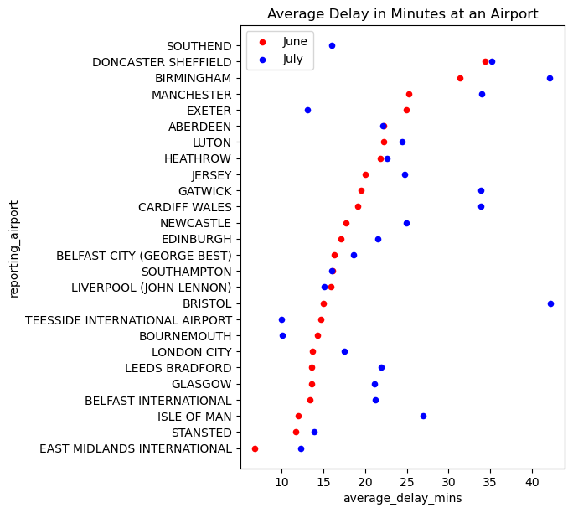
Average Delay in Minutes at an Airport
This graph shows us the average delay in minutes of each airport.
Notes:
This graph shows us the average delay in minutes of each airport.
The maximum time delay in Minutes in July was at Bristol which averaged at around 45 minutes followed by Birmingham at around 40 Minutes.
The maximum time delay in Minutes in June was at Doncaster Sheffield which averaged at around 35 minutes .
The minimum time delay in Minutes in July was at Teeside Internation Airport which averaged at around 10 minutes.
The minimum time delay in Minutes in June was at East Midlands International which averaged at around 5 minutes.
Maximum Change was seen in Gatwick and Cardiff Cardiff's time delay changed from about 17 minutes in June to about 35 minutes in July Gatwick's time delay changed from about 20 minutes in June to about 35 minutes in July.
We can see that Exeter,Teeside and Bournemouth had decreased time delay July comparitively to June so it's a positive change

